Slide 1
Architecture Intake Requirements
22 April 2024
Confidential

Slide 2
Architecture Intake Requirements
The purpose of this document is to provide a template for information needed by GTS Architecture. It is essential to provide of clear and well-documented requirements, budget documentation, stakeholder involvement, and upfront information to streamline the process and ensure the solution meets objectives efficiently.
Having clear and well-documented requirements helps ensure that the architecture solution aligns with the overall goals and objectives of the project. It allows the architecture team to understand the scope of work and make informed decisions about the design and implementation of the system.
Providing upfront information saves time and effort, streamlining the process and ensuring the solution meets objectives efficiently.

Slide 3
Architecture Intake Requirements
Business Problem
Business Value
A high-level design from your business unit architecture group
List of Stakeholders: i.e.. Executive Sponsor, Product Owner, local architect contact, budget holder
Key Contributors/SMEs to consult.
Business Units Impacted
Business Requirements
Success Criteria
Functional and Non-Functional Requirements
Data Classification (Confidential, Strictly Confidential, Internal, Public) See Page 5 for examples.
Project name and project number
Cost Center
Cost Center Owner
Budget

Slide 4
Business Problem
Please provide a detailed summary of the business problem you are trying to solve and the motivation for change.
The existing building fire alarm system in Edinburgh is end of life and is being replaced as a lifecycle requirement. The fire system being installed is provided by JCI who are the same vendors who provide our existing physical security system across Edinburgh and Witham. We are looking to integrate the new fire alarm system into our existing security system on completion to allow better monitoring and visibility on faults/activation to allow our security officers to respond to critical situations generated from this life safety system.
Our existing security system resides on a purpose-built security enclave within the GTS network, therefore we require input from GTS architecture to understand their requirements for us to be able to provide a physical connection between the fire and security systems. Software integration will be configured by the vendor, however it is the connection of the main fire panel into the victor server (which resides on GTS network) that will specifically require a design solution in order to implement on completion of the fire alarm replacement installation.

Slide 5
Business Value
What is the business value of solving the problem?
This is a critical life safety system being replaced and the value of integration is to provide improved monitoring, reaction and pinpointing of issues which will be visible on building maps located within the security control centre on their existing security media wall.

Slide 6
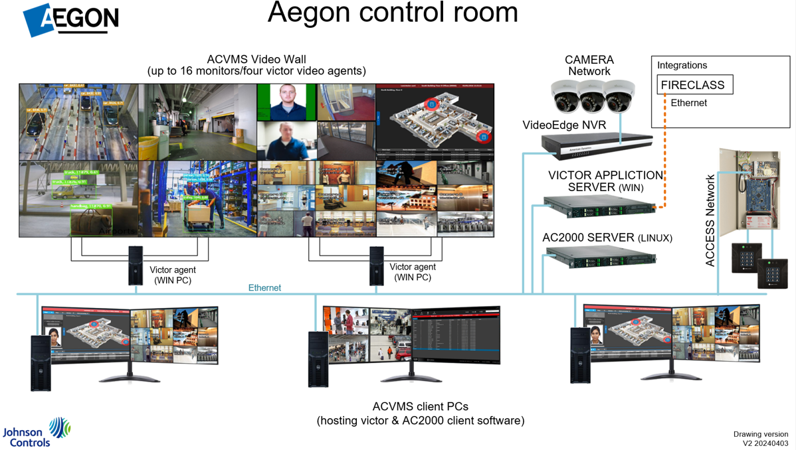
High Level Design
A high-level design from your business unit architecture group

Slide 7
Key Stakeholders
Examples include Executive Sponsor, Product Owner, local architect contact, budget holder
Stakeholder | Role
Lynsey Fotheringham | Budget Holder / Sponsor
Neil McGregor | Project Manager (external – FES) / nmcgregor@fes-group.co.uk
Michelle Marnock | Local Area Contact

Slide 8
Key Contributors/SMEs
Key Contributor/SME | Role | Subject 02 | Subject 03
Michelle Marnock | Local Contact | Michelle will liaise with 3rd party suppliers for info as this is an external project

Slide 9
Business Unit(s)/Team(s) Impacted
What business unit and teams are impacted
BU/Team | Contact
Property Services | Michelle Marnock

Slide 10
Business Requirements
Describe why the project is needed, whom it will benefit, when and where it will take place, and what standards will be used to evaluate it.
Requirement ID | Requirement
BR. 1 | Our existing building fire alarm system in Edinburgh is end-of-life, therefore is due for life cycle replacement. The installation of the new Fireclass system will begin physical works in May, which will not impact GTS as this is a stand-alone system.
BR. 2 | On completion, we are looking to integrate this into our existing physical security system to provide a seamless experience for our users (security officers) who will be monitoring for faults and any issues. As this is a life safety system for the building, we feel having this integration provides a fail-safe way to improve reliability by automation other than human intervention as is current.
BR. 3
BR. 4

Slide 11
Success Criteria and Measurement
What measures will be used to determine whether a project has been successful?
Req ID | Requirement | Measure
SC. 1 | Connection from existing Security Victor system which currently resides on a purpose built security enclave within the GTS network to new Fireclass system fire alarm main panel via ethernet connection to allow seamless integration between the 2 systems to allow monitoring of the fire alarm system through existing security control room media wall | Successful connectivity
SC. 2
SC. 3
SC. 4

Slide 12
Functional Requirements
A Function requirement will capture the required behaviour in terms of functionality and the technology implementation of the business processes. A FR should outline the expected outcome from a stakeholder viewpoint.
FR ID | Requirement | Measure
FR. 1 | Connection from existing Security Victor system which currently resides on a purpose built security enclave within the GTS network to new Fireclass system fire alarm main panel via ethernet connection to allow seamless integration between the 2 systems to allow monitoring of the fire alarm system through existing security control room media wall | Visibility on the media wall for security officers of the Fireclass system.
FR. 2
FR. 3
FR. 4

Slide 13
Non-Functional Requirements
Focused on how the system goes about delivering a specific function. Ie. Speed, Availability, Capacity. NRFs usually have a metric that can be measured. (e.g. Availability/RPO/RTO)
Req ID | Requirement | Measure
NFR. 1 | Integration is not business critical as both the fire and security systems will work independently, however the integration is to improve security measures in the event of an issue | n/a
NFR. 2
NFR. 3
NFR. 4

Slide 14
Data Classification
Please provide the data classification related to any data this request will impact. Examples can be found on page 5 of this document.
Class Definition | Yes | No
Strictly Confidential: Information that is extremely sensitive. |  | x
Confidential: Information that is sensitive |  | x
Internal: Information owned by Aegon and utilized in day-to-day business operations. | x
Public: Comes from public sources or available to general public |  | x

Slide 15
Other Information: Project Number/Financial
Project Name: Fireclass Installation
Project Number: N/A – external Aegon project and installation
Please provide the information below.
Cost Center: 2700
Cost Center Owner: Lynsey Fotheringham
What has been budgeted for this initiative:
$6,000

